Slide 1



Done By: Marwan Al-Hinai.

Slide 2
Circuits Monitoring System Marwan Rashid Alhinai, Asila Said Alalwi, Ftema Rashid Alazri University of Technology and Applied Sinces, Ibri, 76s1815923@ict.edu.om University of Technology and Applied Sinces, Ibri, 76j1918495@ict.edu.om University of Technology and Applied Sinces, Ibri, 76s177@ict.edu.om

Slide 3
Abstract
Nowadays most of the devices are connected through the internet and most of the devices are a smart device which can do more than one task in a time. These smart devices like IOT devices can do a great job in this case. The main goal of this project is to produce an IOT device that will monitor the increase and decrease pf the temperature in the circuits
Problem Statement
Nowadays one of the main problems people faces is the sudden stop of electricity service. Most of the time, the people who get affected by this collapse they will lose money to fix the damages that will happen inside their homes or buildings, and the loss in the food and some electronic devices so these circuit breakers must be monitored all the time. Hence, as an effective solution we come up with a device to monitor the circuit breakers to avoid any damages that can happen because circuit breakers collapse.

Slide 4
Aim & Objectives
This project aims to build a develop a device to reduce the heat and notify the electrician in case of overheat in the circuit breaker so it will detect the heat and reduce the heat in the circuit breakers. Additionally, will help to avoid any type of damage, collapse, or explosion in the circuit breakers
To study related material, published works, and investigate the causes why circuit breakers collapse
To provide a device/system where companies can monitor their device that will help pre-determine a critical situation to avoid loss of money to the owner and damages to appliances and food wastage to homes. The system is where you can see levels of circuit break temperatures at different times of the day

Slide 5
Methodology
1.Information gathering:
•Search in the internet.
•Asking a professional people who are good in electronics, electricity.
•Tacking some start points from previse projects.
2.Analize:
•The device will be done by a smart component which related to IOT technology.
•This technology requires a specific part, and these parts are collected by order form online store and asking some people who worked with the same technology.
3.Design:
•First design was by using a chart in MS Word and PowerPoint and connect some existing component to check.
•Try some platform to check the connectivity and availability of needed services.
•Second design by using Cisco Packet Tracer.

Slide 6
Data Analysis
Technical requirements
Functional Requirements
IOT device ready to test temperature.
A full network with a server connects the IOT device.
Monitoring device and equines.
A storage device or mechanism to save the data.
Security methods include securing the data, monitor machine, and physical security.
The data will be secured during sending from the device to the server.
The data will be secured during sending from the server to the monitor machine.
The room that includes the device inside will have a physical protection.
2.2.3. Non-functional Requirements
Security
Efficient system
Speed
availability

Slide 7
Results
We conduct a functional system which is can monitor the circuit temperature. The system will conduct readings of the temperature in each circuit in the building by using the sensors to take the readings and send it to the monitor screen. These devices will be near or connected to the circuits and it will be connected a specific server that will receive the readings and it will be displayed in the screen.

Slide 8
Sample Table of Findings and Observations
Findings | Observations
This system will help the improve the safety | When the device detect the temperature changes it will make easy to deal with it before the damage happen
Will conduct a good way to monitor | The monitoring will help to avoid any stop or damage but it could be improver by adding a control features
The system will help to avoid any lose in life's, construction, and circuit it self | Reduce the damages that could happen so it will safe the people who inside that building and the building will stay safe

Slide 9
DHT Sensor
Node MCU
Node Red Server
Monitoring Screen
DHT Sensor
Node MCU
Raspberry Pi
DHT Sensor
Node MCU
DHT Sensor
Node MCU

Slide 10
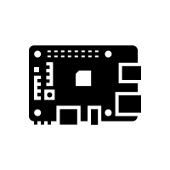
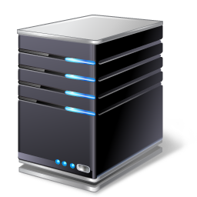

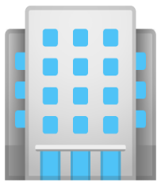
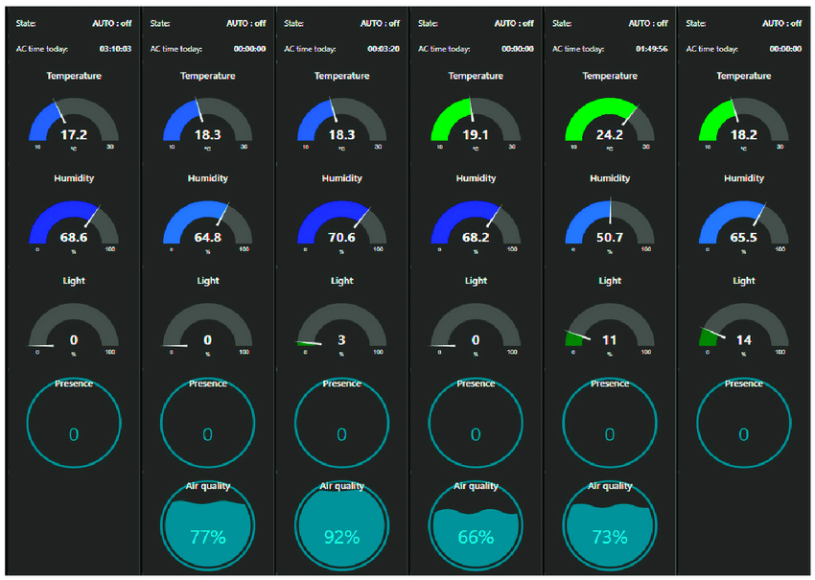
Encryption
Device 1
Device 2
Encryption
Encryption
Raspberry Pi
Server
Monitor Screen
Device 3
Device 4
Encryption

Slide 11
Conclusions
To sum up with that this project will conduct a smart way to monitor the circuits. The circuit problems can be led a big damages to the buildings so our device will help to avoid these damages. Monitoring the circuits will help to identify and detect the overheat in the circuits to act before its reach to a critical point.

Slide 12
References
[1]. https://www.irjet.net/archives/V4/i5/IRJET-V4I5131.pdf
[2]. https://www.ripublication.com/ijaer18/ijaerv13n10_73.pdf
[3]C. Fu and J. Hao, “High Voltage Circuit Breaker on-Line Monitoring System,” Advanced Materials Research, vol. 898, no. 15, pp. 668–671, Feb. 2014, doi: 10.4028/www.scientific.net/amr.898.668.
[4]G.Nandakumar, B.Praveenkumar, K.Selvakumar, and L. Sarojini, “Password Control Multi Line Circuit Breaker Using IoT,” International Journal of Computer Sciences and Engineering, vol. 6, no. 12, pp. 718–724, Dec. 2018, doi: 10.26438/ijcse/v6i12.718724.
[5]https://www.engineersgarage.com/overheat-overcooling-circuit-breaker-using-temp-sensor-lm35-comparator-lm339/
[6]https://www.engineersgarage.com/overheat-overcooling-circuit-breaker-using-temp-sensor-lm35-comparator-lm339/
[7] http://www.ijarse.com/images/fullpdf/1513918941_P235ijarse.pdf review on circuit breakers technology for short circuit and over voltage protection

